Slide 1
Student Employment Training: The Keys to Success at CalArts and beyond

Slide 2
Who’s Here?
Ryan Akers
Assistant Director of Student Employment
Students, introduce yourselves!
Tell us your name, pronoun, year and major, and what your student worker role is.

Slide 3
ice breaker
Would you rather have more time or more money?
What are your 3 favorite food dishes?
If you could have lunch with 1 person, who would it be and why?

Slide 4
Student Employment Program Goals
By working on-campus you will have the opportunity to:
Gain professional skill sets
Meet new students, staff, and faculty
Become more involved with campus
& BUILD YOUR RESUME!
Provide financial assistance to students to help fund their academic studies.
Students can make about $3,000 extra for one academic year of work
Great spending money
4

Slide 5
Quick Facts
As a student employee you….
May only work up to 25 hrs. per week (40 hrs. during school breaks)
* international students are allowed to work a maximum of 20 hours per week and 40 hours during school breaks
Must remain enrolled at least part-time throughout the duration of your employment
Be authorized to work in the US
What else?!
Must submit your time card every two weeks throughout the semester
Be sure to list time you are actually working
Paper time sheets will be needed if you don’t submit your hours

Slide 6
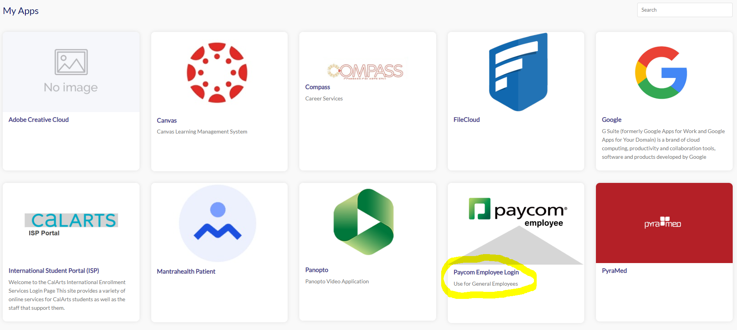
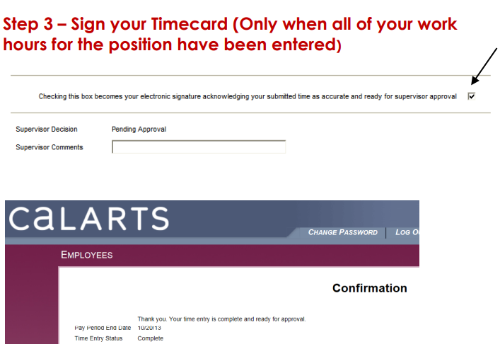
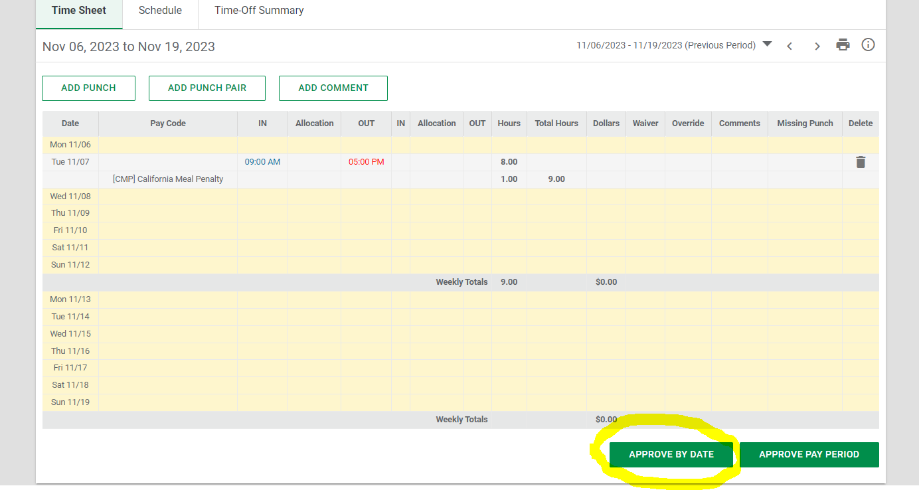
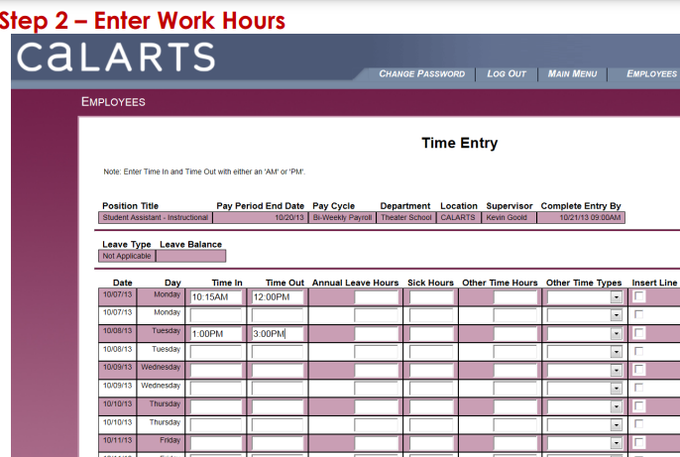
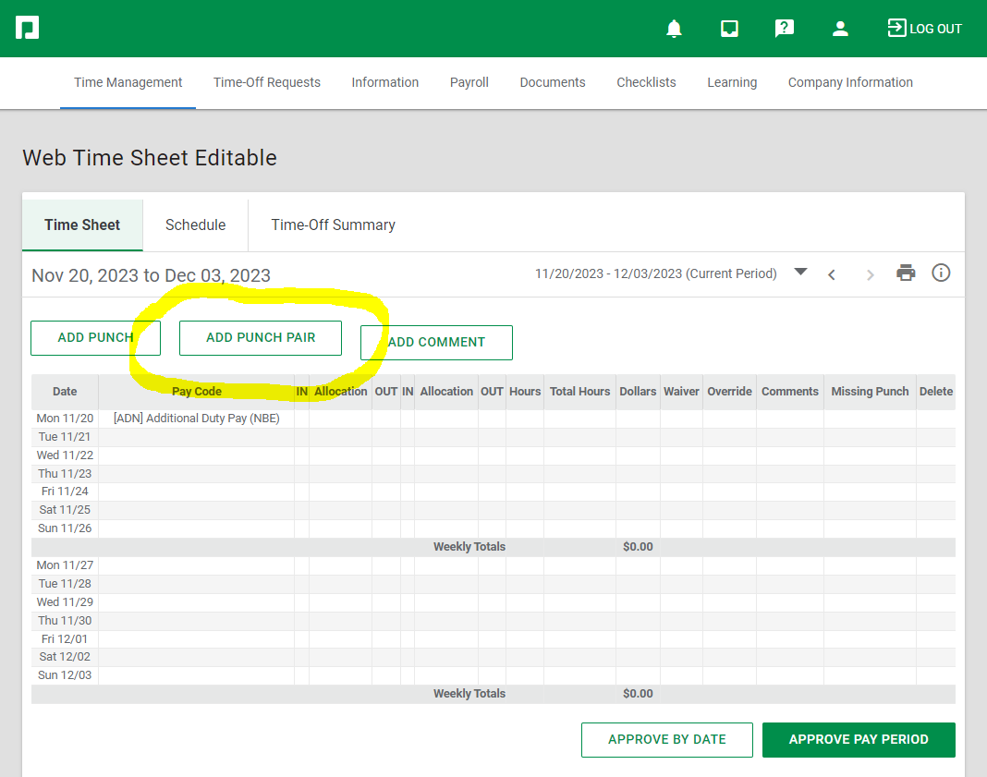
Submit your timecard in Paycom every two weeks

Slide 7
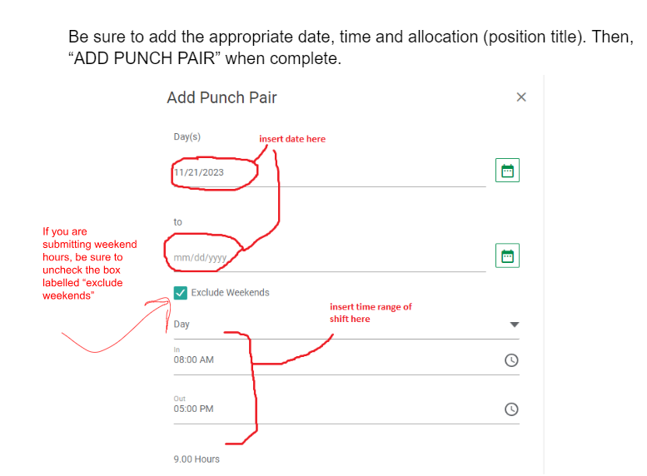
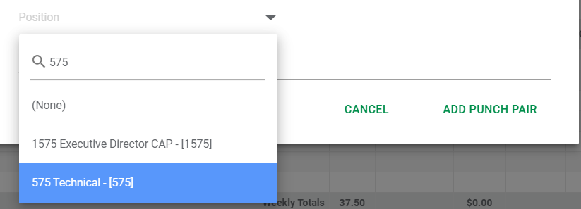
The week you are entering data for appears at the top left corner.
You will need to fill out your timesheets for each week and submit for approval.
Select your "Time in" and "Time out" times from the dropdown list or you can type in the time directly.
Make sure you type in the correct position code.
Don't forget to include a lunch if you take one
Once finished select submit for approval then your supervisor will approve. Once approved you will receive an email

Slide 8
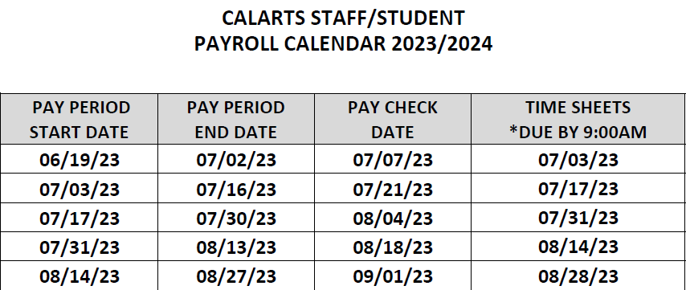
Mistakes Happen…. Here’s How to Fix Them
1. Missing a timecard
- Let your primary supervisor know right away
- If they are still able to access your timecard, they can make the correction for you
- If your supervisor cannot fix it, contact the Payroll office
Making an error on your timecard
- Let your supervisor know and they may be able to fix it, if the deadline has not passed

Slide 9
Meal Breaks & Rest Breaks
REST BREAK: If you work at least 3.5 hours in one day, you are entitled to a rest break of at most 10 minutes (this is paid and not indicated on your timecard)
MEAL BREAK: If you work 5 hours in a row on one day, you are entitled to a meal break of at least 30 minutes.
Run this by your supervisor when you plan to leave for lunch
The employee and employer can agree to waive this meal period provided they do not work more than 6 hours in the workday.
This break is unpaid and documented on your timecard

Slide 10
Sick Leave
Rule of Thumb: If you are sick, do not come to work!
Give ample notice
If you aren’t feeling well the night before your shift, let your supervisor know
If you start feeling sick during the day of your shift, give as much notice as possible
Let both your primary supervisor and a secondary supervisor know
Do not come back to work until you are feeling better
Your Sick Leave accrues at a rate of .33 per 1 hours worked or 1 hour for every 30 hours worked. Up to 24 hours of that sick leave carries over to the next calendar year. Accrued hours are viewable on Paycom
**USE IT OR LOOSE IT***

Slide 11
Start your job off on the right foot.
The first few weeks of a new job can be exciting, but also very overwhelming and stressful, let’s go over some ways to start your position on the right (or left) foot!
11

Slide 12
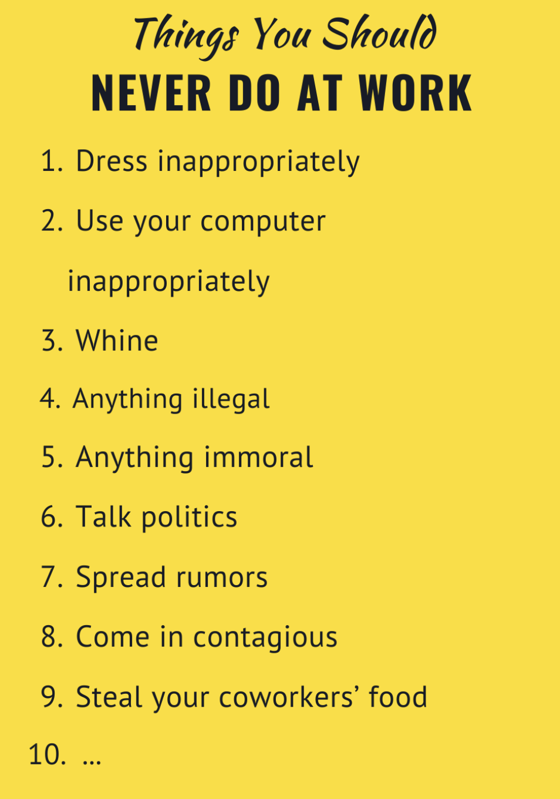
What else is missing?

Slide 13
“Not Just an On-Campus Job” – Accountability and Reliability
Your first priority is academics, but while you are at work, you are expected to approach your job professionally and give 100%
Over 400+ on-campus student employees work at CalArts, that’s more than faculty and staff combined!
Show up for yourself and your department
You are expected to be at your job when you are scheduled to work.
If you have to call out sick, do so as early as possible (preferably the night before your shift)
If you are going on a trip or missing work for some other reason (outside of an illness) this is not considered sick time and you will not be paid for the hours missed.
Let your supervisor know as early as you can that you will be out for an extended period

Slide 14
Professionalism – Have a Positive Approach
Lead with curiosity, not judgement
Spoiler Alert: Your On-Campus job may not be your favorite job
Consider the benefits: Gaining work experience, earning extra cash, having a flexible schedule and a supportive professional supervisor in a convenient location.
“My on-campus jobs isn’t related to my program!”
Consider what you are learning about the world of work: what skills are you gaining in your position?
Think about TRANSFERABLE SKILL SETS
Customer service, phone skills, software knowledge, creativity
Be enthusiastic about learning new tasks and/or taking on additional responsibilities!

Slide 15
Get to you know your office and their expectations:
Supervisor Expectations:
Arrive on time for every shift! Even better, 5 minutes early
Take notes during training and don’t be afraid to ask questions
Only call in sick if you are actually sick
Be sure you know who to contact and how to call in sick
Avoid doing homework while on the clock unless specified by your supervisor, they are paying you to work
Say “Good morning” or “Good afternoon”, build relationships with your supervisors and co-workers

Slide 16
During Training:
Take notes & ask questions!
Your supervisor is there for you and wants to help you
It is okay to feel overwhelmed, the learning curve will end soon and you will be an expert in no time!
Throughout the Academic Year:
Continue to show up on time!
Show dedication and enthusiasm about the work you are doing, you are making a huge impact on CalArts!
When you don’t have anything to do, ask for projects or assist with organizing the office
Keep building relationships with your supervisor and co-workers (they may be a reference in the future)
Look for ways to get involved on campus!

Slide 17
Don’t be Dwight…. Make sure to:
Have a clean appearance
Don’t wear headphones to work
Don’t ignore or avoid guests
Keep good posture at desk
Keep personal talk out of the office
Keep your phone in your bag or pocket, not on the desk
Maintain good eye contact with visitors
Never give out confidential information (when in doubt, ask)

Slide 18
What are other aspects to consider?
How to work with different demographics (for instance, how to work with older individuals, being mindful of someone else’s identity, providing clear directions, speaking clearly and making eye contact, etc.)
Asking and clearly assessing how to approach your supervisor with questions or for input (aka, try Googling to find an answer first)
Understanding your supervisor’s preferences (trying to work on a project first before deciding whether to request training, or should I immediately come with questions)
How to give the supervisor feedback about their leadership style and whether the working relationship could be better served if xyz was in place

Slide 19
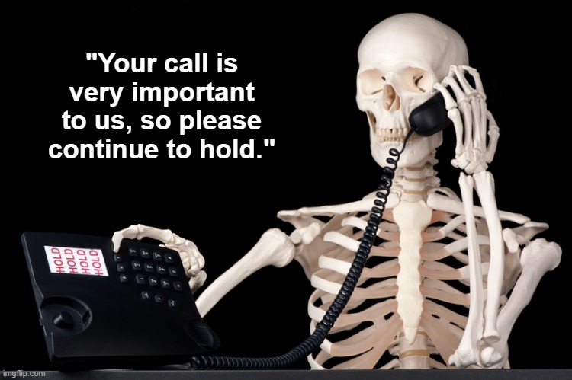
Customer Service Over the Phone…
If you are new to answering phones, don’t worry. When in doubt,
place the caller on hold and ask someone for help.
Try your best to answer their questions, you can always take down their information and call them back (don’t forget!)
Smile while talking, it makes you sound enthusiastic!
Always use positive language
If the caller asks for someone who is not there:
Without positive language: "I'm sorry they are not available at the moment, please call back"
With positive language: "Unfortunately, they are not currently available. I am happy to pass along a message to them and they can call you back when they are available“
If the caller asks you a question that you don't know the answer to:
Without positive language: "I'm sorry, but I don't know“
With positive language: "I'm not sure of the answer. Do you mind if I place you a brief hold so I can get the correct answer for you?"

Slide 20
Phone Etiquette Overview
https://www.youtube.com/watch?v=Fii-Knk9lZc

Slide 21
Phone Etiquette Overview
Always answer the phone by saying: “Hello, thank you for calling the ___ office at CalArts, how may I help you?”
When placing a call, state your name and where you are calling from "Hello, my name is Sandy from the ____ office at CalArts. May I please speak to...."
Think through exactly what you plan to say BEFORE placing the call
Do not allow interruptions to occur during conversations. If this is not possible, "My apologies, an urgent matter has come up, may I place you on a brief hold?"
When leaving a message talk clearly and slowly, leave your phone number twice

Slide 22
FERPA Overview
Family Educational Rights and Privacy Act (1974)

Slide 23
What is FERPA?
https://www.youtube.com/watch?v=CTv0aHw1AFI

Slide 24
Your On-Campus Work Experience Matters
Let’s go over how to list your position on your resume!

Slide 25
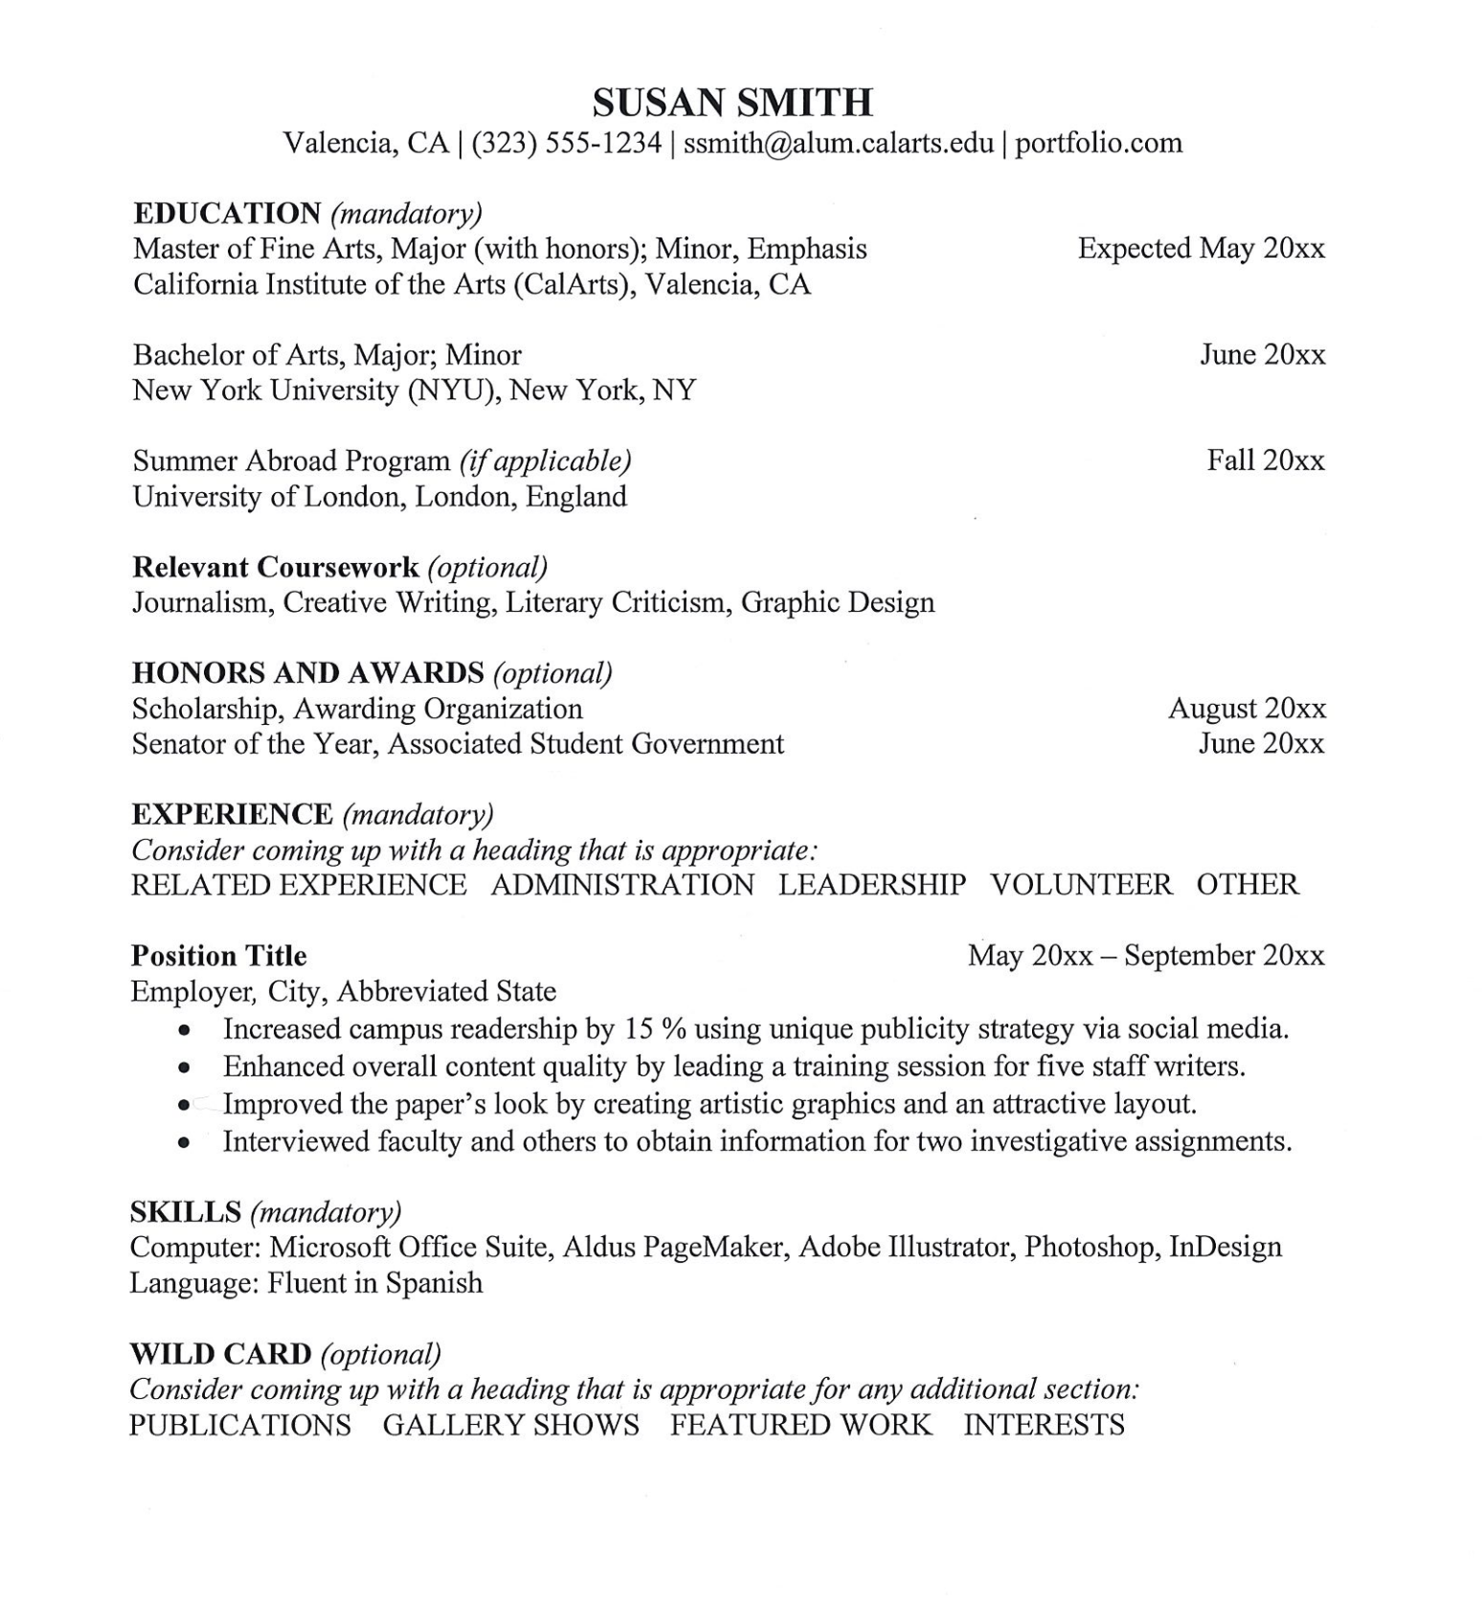
Resumes in a
** Capture the employer’s attention in 10 seconds or less***
Include descriptive bullet points that are specific.
Think about what you do everyday…write this down!

Slide 26
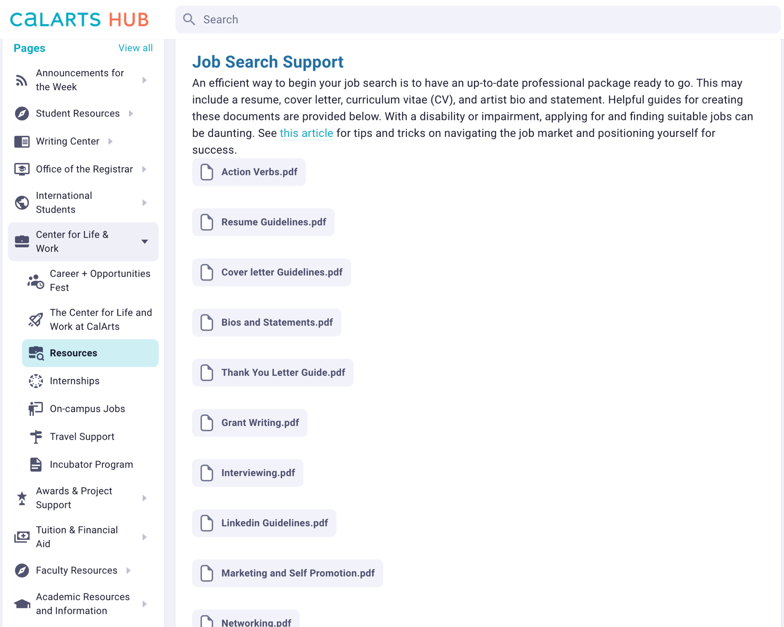
The Center for Life & Work’s page on the Hub contains tons of information and resources to help guide you through your job search and career exploration during and after your time at CalArts

Slide 27
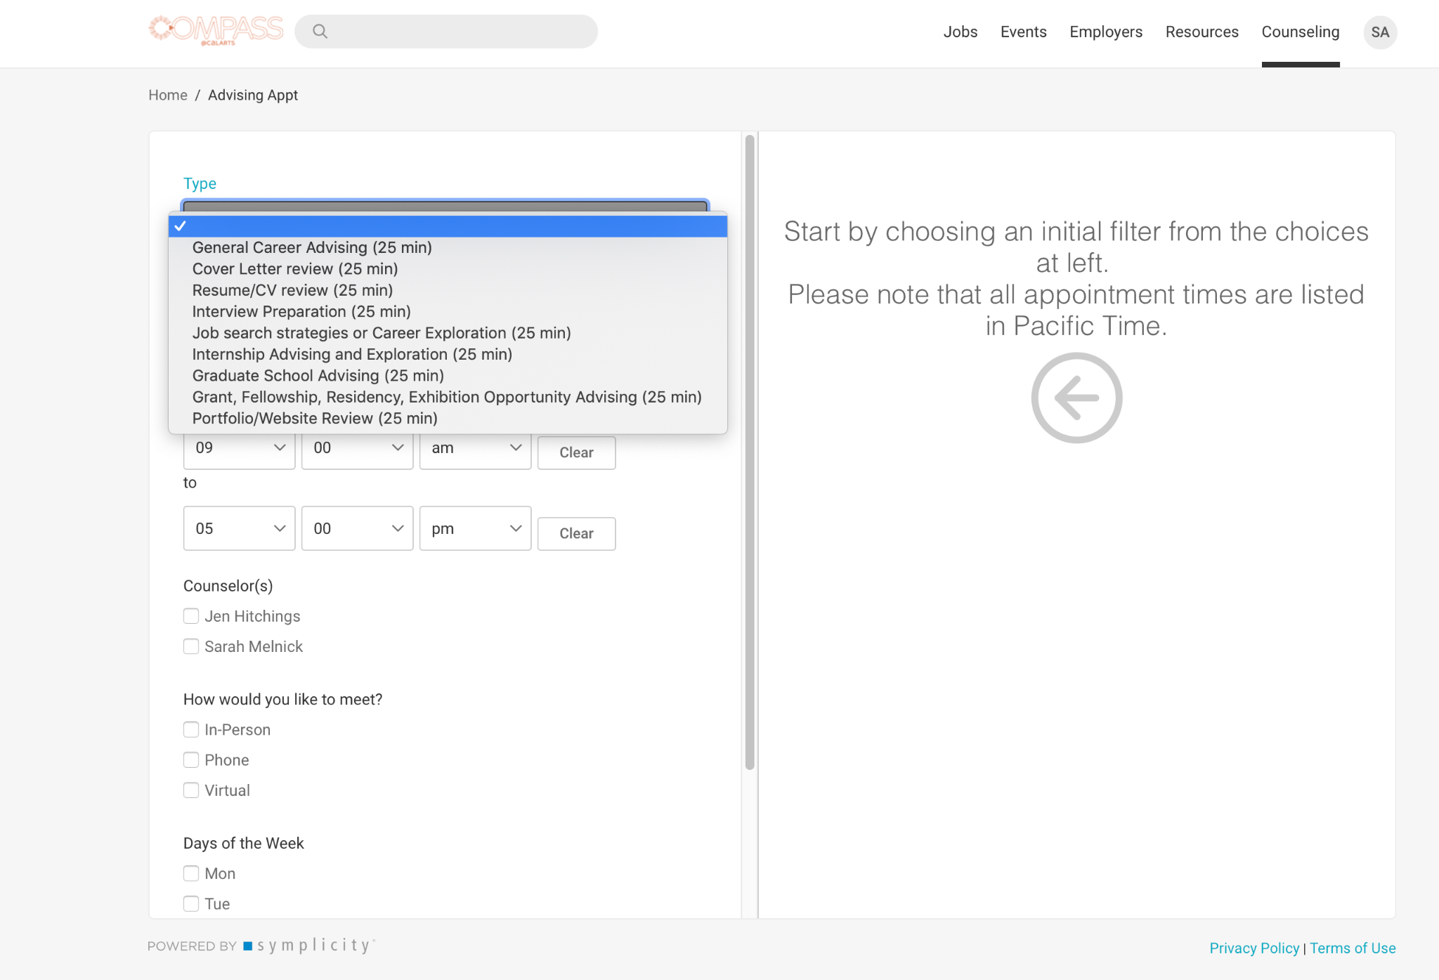
Scheduling Career Advising appointments with Life & Work Advisor Sarah Melnick through Compass
Or, email smelnick@calarts.edu to get your Compass profile set up while discussing any job search or professional packet concerns

Slide 28
Upload Your Resume to Compass for review!
You will be well on your way to getting that next internship or job.

Slide 29
THANK YOU!
Any Questions?

